Slide 1
1-Gyms Table
Field | Type | Description
Gym ID | Primary Key | Unique Gym identifier
Name | VARCHAR | Gym name
address | VARCHAR | Gym address
Phone number | VARCHAR | Gym phone number

Slide 2
2-Members Table
Field | Type | Description
Member ID | Primary Key | Unique member ID
First Name | VARCHAR | Member's first name
Last Name | VARCHAR | Member's last name
Address | VARCHAR | Member's address
Date of birth | DATE | Member's date of birth
Gender | VARCHAR | Member's gender
Gym ID | Foreign Key | Gym where registered

Slide 3
3- Sessions Table
Field | Type | Description
Session ID | Primary Key | Unique session ID
Sport type | VARCHAR | Type of sport
Schedule | DATETIME | Session time
Max capacity | INT | Max members (20)
Gym ID | Foreign Key | Gym where held

Slide 4
4- Coaches Tables
Field | Type | Description
Coach ID | Primary Key | Unique coach ID
First Name | VARCHAR | Coach's first name
Last Name | VARCHAR | Coach's last name
Age | INT | Coach's age
Specialty | VARCHAR | Coach's specialty

Slide 5
5- Sessions Coaches
Field | Type | Description
Session ID | Foreign Key | The ID of the Session
Coach ID | Foreign Key | The ID of the Coach

Slide 6
6-For registrations
Field | Type | Description
Registration ID | Primary Key | Unique registration ID
Member ID | Foreign Key | The ID of the member
Session ID | Foreign Key | The ID of the Session

Slide 7
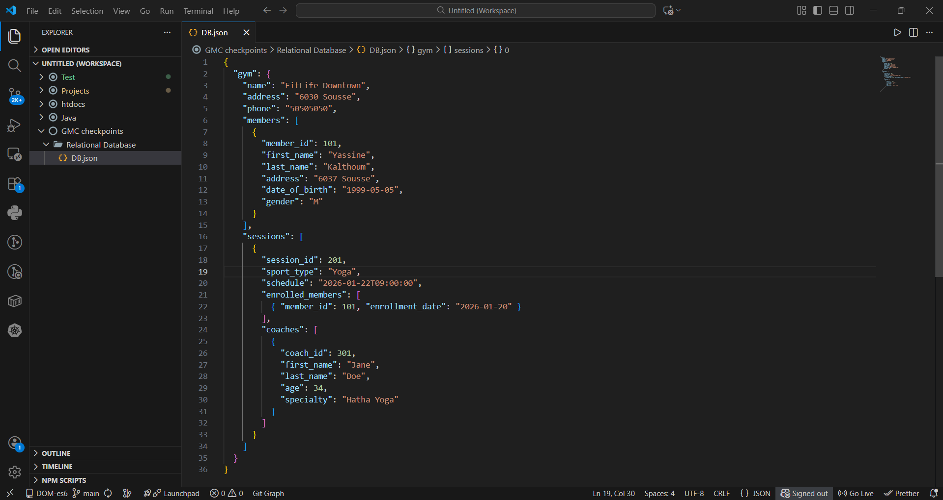
Hierarchical Format

